Slide 1
DATA COMMUNICATIONS
Data Communications and Networking, Behrouz A Forouzan,
4th edition, 2006, TMH
Mrs P Lavanya
Asst. Prof.
E. C. E. Dept.

Slide 2
Data – refers to information presented in whatever form is agreed upon by the parties creating and using the data.
Communication – process of exchanging information
“Data Communications are the exchange of data between two devices via some form of transmission medium.”
For data communications to occur, the communicating devices must be part of a communication system made up of a combination of hardware (physical equipment) and software (programs).

Slide 3
Effectiveness of data communications system depends on four fundamental characteristics:
  Delivery – The system must deliver data to the correct destination
  Accuracy – The system must deliver the data accurately.
  Timeliness – the system must deliver data in a timely manner.
  Jitter – refers to the variation in the packet arrival time. It should be zero.

Slide 4
UNIT - I

Slide 5
Contents
Introduction
- Components
- Data Representation
- Data Flow
Networks
- Network Criteria
- Physical Structures
- Categories of Networks
The Internet
Protocols and Standards
Network Models
- Layered Tasks
- The OSI Model
- Layers in the OSI Model
- TCP/IP Protocol Suite
- Addressing

Slide 6
Introduction(1)
Components
- A data communications system has five components.
1. Message – it is the information to be communicated. Popular forms of information include text, numbers, pictures, audio, and video.
2. Sender – It is the device that sends the data message. Ex: computer, workstation, telephone handset, video camera, and so on.
3. Receiver – It is the device that receives the message. Ex: computer, workstation, telephone handset, video camera, and so on.
4. Transmission medium – It is the physical path by which a message travels from sender to receiver. Ex: twisted-pair wire, coaxial cable, fiber-optic cable, and radio waves.
5. Protocol – It is a set of rules that govern data communications. It represents an agreement between the communicating devices. Without a protocol, two devices may be connected but not communicating.

Slide 7
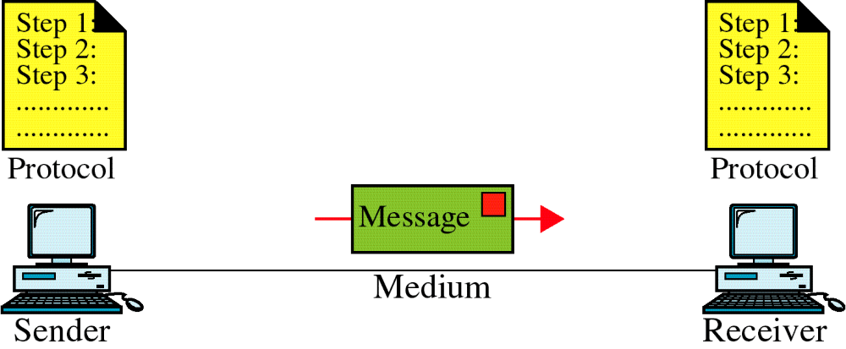
Introduction(2)
Fig. 1.1 Five components of data communication

Slide 8
Introduction(3)
Data Representation
- Information today comes in different forms such as text, numbers, images, audio, and video.
Text – In DC, text is represented as a bit pattern, a sequence of bits. Different sets of bit patterns have been designed to represent text symbols. Each set is called a code, the process of representing symbols is called coding. The coding system used today is: Unicode, uses 32-bit to represent a symbol or character used in any language in the world.
Numbers – represented by bit patterns.
number is directly converted to a binary number.
Images – represented by bit patterns. In its simplest form, an image is composed of a matrix of pixels, where each pixel is a small dot. The size of the pixel depends on the resolution. After

Slide 9
Introduction(4)
small dot. The size of the pixel depends on the resolution. After an image is divided into pixels, each pixel is assigned a bit pattern. The size and value of the pattern depend on the image.
color images – each color is made of a combination of three primary colors. Ex: RGB (red, green, blue), YCM (yellow, cyan, magenta)
Audio – refers to the recording or broadcasting of sound or music. By nature, it is different from text, numbers, or images. It is continuous, not discrete.
Video – refers to the recording or broadcasting of a picture or movie.

Slide 10
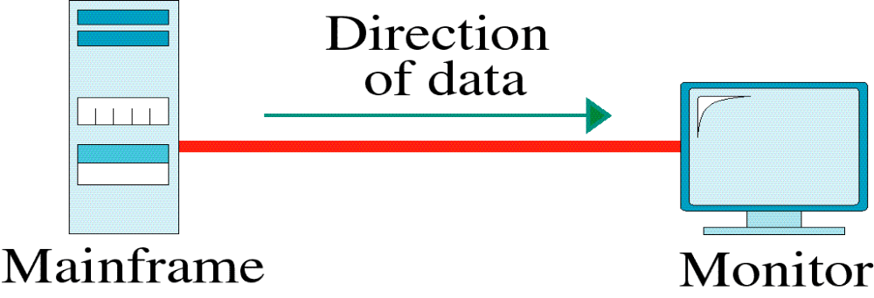
Introduction(5)
Data Flow
- Communication between two devices can be simplex, half-duplex, or full-duplex
Simplex – Communication is unidirectional: only one of the two devices on a link can transmit; the other can only receive.
- entire capacity of the channel is used
- Ex: Keyboards, Traditional Monitors

Slide 11
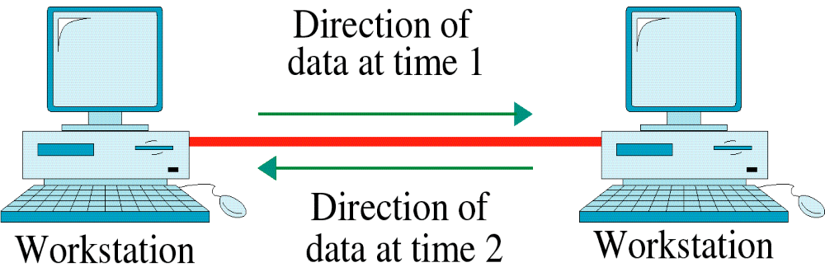
Introduction(6)
Half-Duplex – each station can both transmit and receive, but not at the same time: when one device is transmitting, the other can only receive, and vice versa.
- entire capacity of the channel is taken over by whichever of the two devices is transmitting at the time
- Ex: Walkie-talkies and CB (citizens band) radio

Slide 12
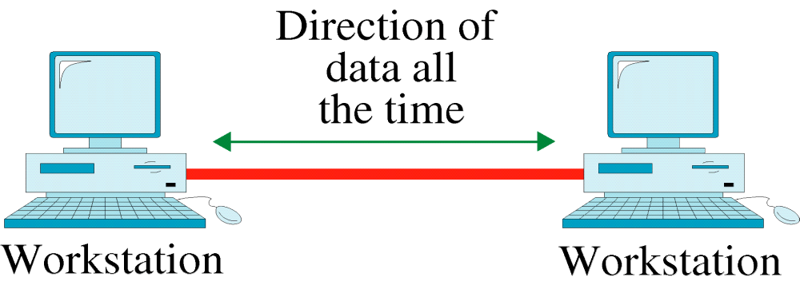
Introduction(7)
Full-Duplex – (also called duplex) both stations can transmit and receive simultaneously
- capacity of the link is shared. Sharing can occur in two ways: either the link must contain two physically separate transmission paths, one for sending and the other for receiving; or the capacity of the channel is divided between signals traveling in both directions.
- Ex: Telephone

Slide 13
Networks(1)
A network is a set of devices (often referred to as nodes) connected by communication links.
A node can be a computer, printer, or any other device capable of sending and/or receiving data generated by other nodes on the network.
Distributed Processing, in which a task is divided among multiple computers. Instead of one single large machine being responsible for all aspects of a process, separate computers handle a subset.
Network Criteria
A network must be able to meet a certain number of criteria. The most important of these are performance, reliability, and security.

Slide 14
Networks(2)
Performance – performance of a network depends on a number of factors, including the number of users, the type of transmission medium, the capabilities of the connected hardwares, and the efficiency of the software.
It can be measured in many ways, often evaluated by two networking metrics: throughput and delay. We need more throughput and less delay.
Reliability – In addition to accuracy of delivery, it is measured by frequency of failure, the times it takes a link to recover from a failure, and network’s robustness in a catastrophe.
Security – include protecting data from unauthorized access, protecting data from damage and development, and implementing policies and procedures for recovery from breaches and data losses.

Slide 15
Networks(3)
Physical Structures
Types of Connection
- A network is two or more devices connected through links.
- A link is a communications pathway that transfers data from one device to another.
- For visualization purposes, it is simplest to imagine any link as a line drawn between two points.
- For communication to occur, two devices must be connected in some way to the same link at the same time.

Slide 16
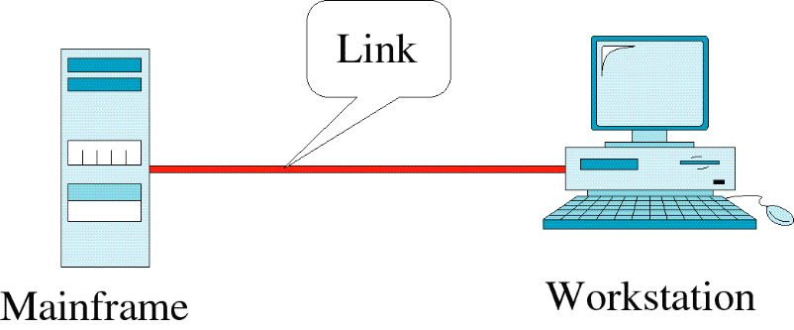
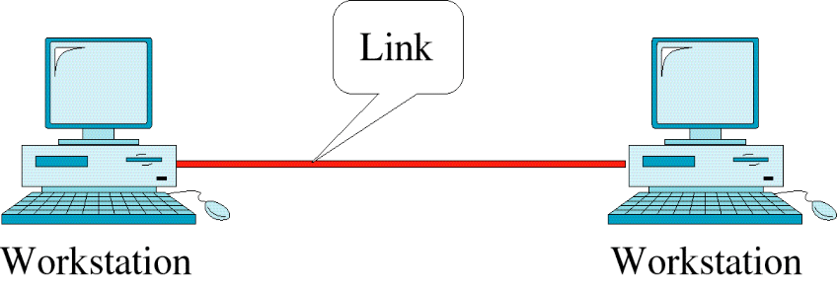
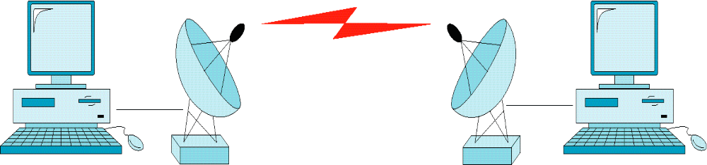
Networks(4)
There are two possible types of connections: point-to-point and multipoint.
Point-to-point: - there is a dedicated link between two devices.
- entire capacity of the link is reserved for transmission between those two devices.
- connection can be a physical wire or cable or a microwave or a satellite link

Slide 17
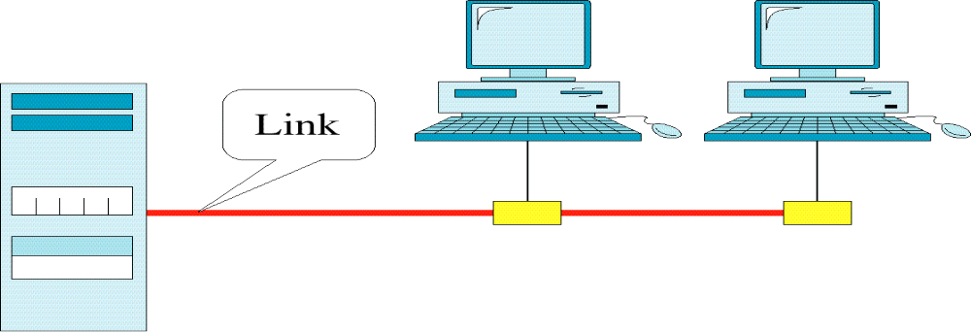
Networks(5)
Multipoint: - also called multidrop
- more than two specific devices share a single link
- capacity of the channel is shared, either spatially or temporally.
- if several devices can use the link simultaneously –
spatially shared connection
- if users must take turns – time shared connection

Slide 18
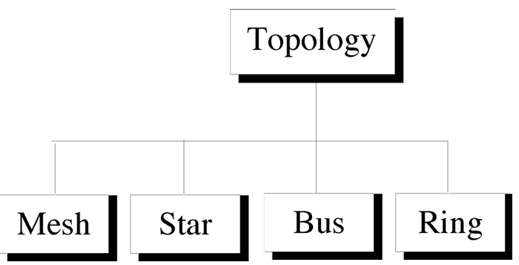
Networks(6)
Physical Topology
Refers to the way in which a network is laid out physically.
Two or more devices connect to a link
Two or more links form a topology.
Topology of a network is the geometric representation of the relationship of all the links and linking devices to one another.

Slide 19
Networks(7)
Mesh
- every device has a dedicated point-to-point link to every other device.
- to have a mesh network with n nodes, n(n-1)/2 physical links are needed.
- to accommodate that many links, every device on the network must have n-1 input/output (I/O) ports
- Advantages:
1. use of dedicated links eliminate traffic problems
2. robust
3. there is the advantage of privacy or security.
4. fault identification and fault isolation easy

Slide 20

- Disadvantages:
1. installation and reconnection are difficult.
2. the sheer bulk of the wiring can be greater than the available space
3. hardware required to connect each link is prohibitively expensive
- limitedly used
Fig. A fully connected mesh topology

Slide 21
Networks(9)
Star
- every device has a dedicated point-to-point link only to a central
controller, usually called a hub.
- devices are not directly linked to one another.
- does not allow direct traffic between devices.
- the controller acts as an exchange: If one device wants to send data to another, it sends data to the controller, which then relays the data to the other connected device.
- Advantages:
1. less expensive than mesh, each device needs only one link and one I/O port to connect it to any number of others.
2. easy to install and reconfigure
3. far less cabling is needed to mesh
4. robustness
5. easy fault identification and fault isolation

Slide 22

- Disadvantages:
1. dependency of the whole topology on one single point, the hub.
2. more cabling is required than in some other topologies
- used in LANs
Fig. A star topology

Slide 23
Networks(11)
Bus
- It is multipoint
- one long cable acts as a backbone to link all the devices in a network
- Nodes are connected to the bus cable by drop lines and taps.
- a drop line is a connection running between the device and the main cable
- a tap is a connector that splices into the main cable
- as a signal travels along the backbone, some of its energy is transformed into heat.
- therefore, the signal becomes weaker and weaker as it travels farther and farther.
- for this reason there is a limit on the number of taps a bus can support and on the distance between those taps.

Slide 24

- Advantages:
1. ease of installation
2. uses less cabling than mesh or star
- Disadvantages:
1. difficult reconnection and fault isolation
2. difficult to add new devices.
3. signal reflection at the taps can cause degradation in quality.
4. a fault or break in the bus cable stops all transmission
- used in the early LANs.
Fig. A bus topology

Slide 25
Networks(13)
Ring
- each device has a dedicated point-to-point connection with only the two devices on either side of it (each device is linked to only its immediate neighbors either physically or logically).
- a signal is passed along the ring in one direction, from device to device, until it reaches its destination.
- each device in the ring incorporates a repeater.
- when a device receives a signal intended for another device, its repeater regenerates the bits and passes them along.

Slide 26

- Advantages:
1. relatively easy to install and reconfigure
2. fault isolation is simplified
- Disadvantages:
1. unidirectional traffic
2. a break in the ring can disable the entire network
- used in Token ring LANs
Fig. A ring topology

Slide 27
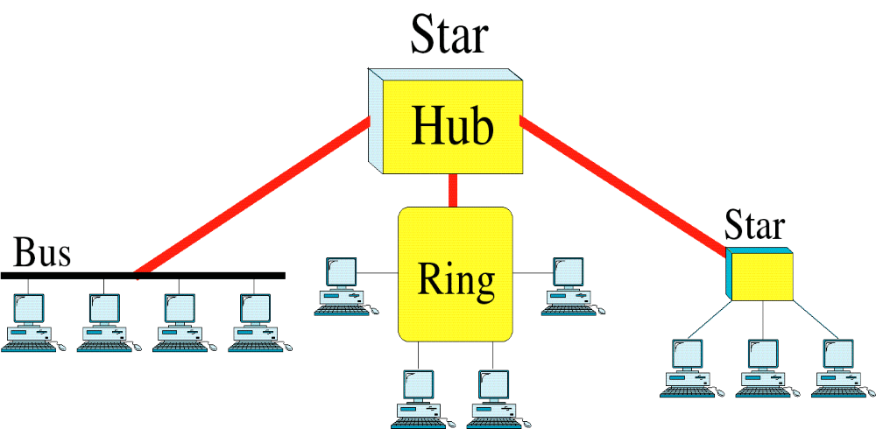
Networks(15)
Hybrid Topology
- a network can be hybrid.
Fig. A hybrid topology: a star backbone with three different networks

Slide 28
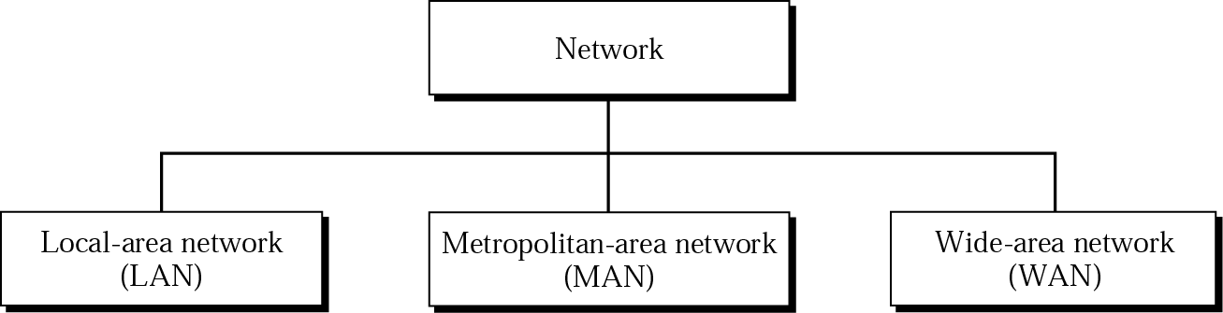
Networks(16)
Categories of Networks
- a network is a group of connected communicating devices such as
computers or printers etc.
- the category into which a network falls is determined by its size.
- a LAN normally covers an area less than 2 mi.
- a WAN can be worldwide.
- networks of size in between are referred to as MANs and span tens of miles

Slide 29

Networks(17)
LAN
- usually privately owned
- links the devices in a single office, building, or campus
- a LAN can be as simple as two
PCs and a printer connected
together in someone’s home
office; or it can extend
throughout a company and
include audio and video
peripherals.
- designed to allow resources
to be shared between PCs or
WSs.

Slide 30
Networks(18)
LAN
- resources to be shared can be hardware, software, or data.
- in addition to size, LANs are distinguished from other types of networks by their transmission media and topology.
- a given LAN uses only one type of transmission medium.
- most common LAN topologies are bus, ring, and star
- today, LANs data rates are normally 100 or 1000 Mbps
- Wireless LANs are the newest evolution in LAN technology

Slide 31
Networks(19)
WAN
- provides long-distance transmission of data, image, audio and video information over large geographic areas that may comprise a country, a continent, or even the whole world.
- a WAN can be as complex as the backbones that connect the Internet or as simple as a dial-up line that connects a home computer to the Internet
- normally refer to the first as a switched WAN and to the second as a point-to-point WAN

Slide 32


Slide 33
Networks(21)
WAN
- swithced WAN connects the end systems, through a router to another LAN or WAN.
- point-to-point WAN is normally a line leased from a telephone or cable TV provider that connects a home computer or a small LAN to an Internet Service Provider (ISP).
- Wireless WAN is becoming more and more popular today.

Slide 34
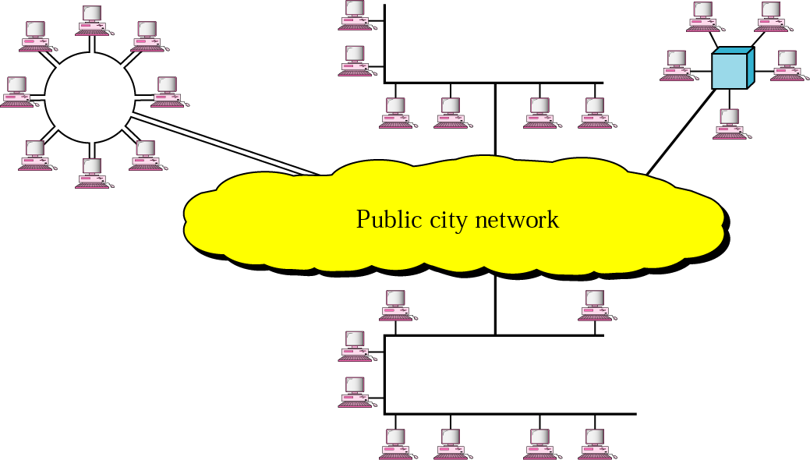
Networks(22)
MAN
- covers the area
inside a town or
a city.
- designed for
customers who
need a high-
speed
connectivity,
and have end-
points spread
over a city or
part of city.
Fig. A MAN

Slide 35
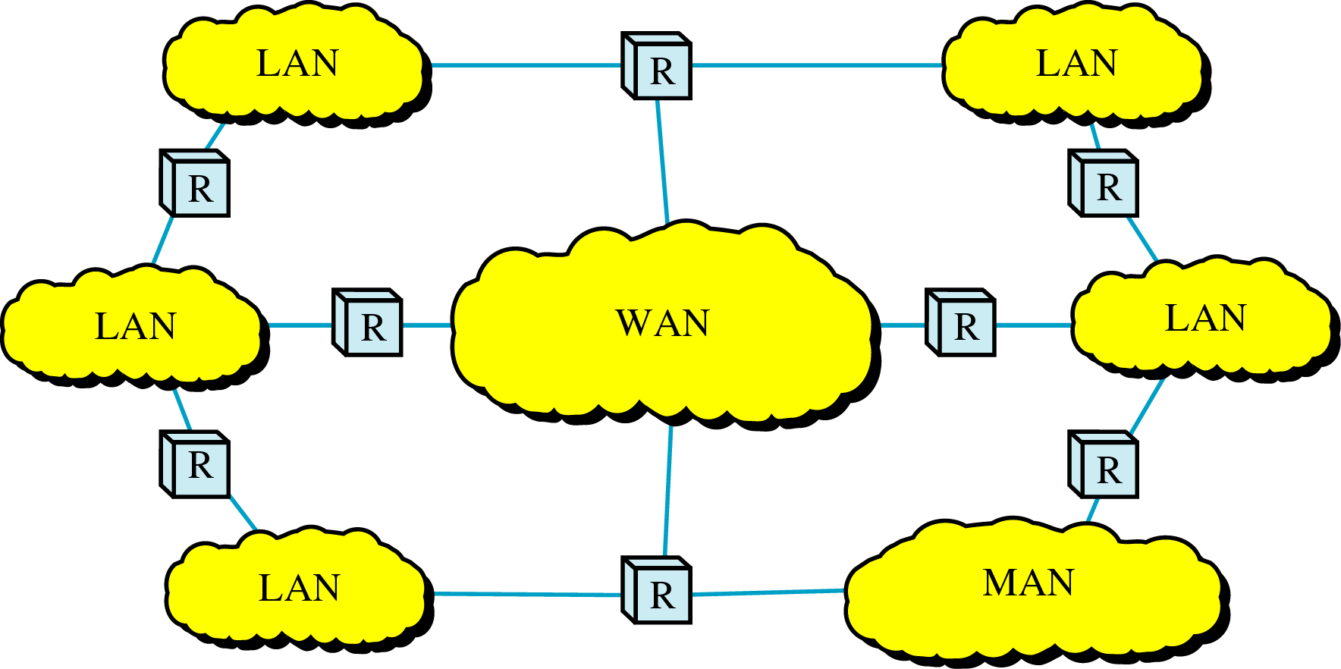
internet
Interconnection of Networks: internetwork
- when two or more networks are connected, they become an internetwork, or internet.

Slide 36
Internet(1)
The Internet
- the Internet is a communication system that has brought a wealth of information to our fingertips and organized it for our use.
- the Internet is a structured, oraganized system
- the most notable internet is called the Internet, a collaboration of more than hundreds of thousands of interconnected networks
- private individuals, government agencies, schools, research facilities, corporations, and libraries in more than 100 countries use the Internet.
- millions of people are users.

Slide 37
Internet(2)
History
- this extraordinary communication system came into being in 1969.
- the Advanced Research Projects Agency (ARPA) in the Department of Defense (DoD) was interested in finding a way to connect computers so that the researchers they funded could share their findings, thereby reducing costs and eliminating duplication of effort.
- In 1967, ARPA presented its ideas for ARPANET, a small network of connected computers. The idea was that each host computer would be attached to a specialized computer, called an interface message processor (IMP). The IMPs, in turn, would be connected to one another. Each IMP had to be able to communicate with other IMPs as well as with its own attached host.

Slide 38
Internet(3)
- In 1969, ARPANET came to reality. Software called the Network Control Protocol (NCP) provided communication between the hosts.
- In 1972, NCP had been given a new name Transmission Control Protocol (TCP) that achieves end-to-end delivery of packets and includes the concepts such as encapsulation, datagram and the functions of a gateway.
- Shortly thereafter, authorities made a decision to split TCP into two protocols: Transmission Control Protocol (TCP) and Internetworking Protocol (IP).

Slide 39
Internet(4)
The Internet Today
- today, Internet is not a simple hierarchical structure
- It is made up of many wide- and local-area networks joined by connecting devices and switching stations.
- It is difficult to give an accurate representation of the Internet because it is continually changing
- today most end users who want Internet connection use the services of Internet Service Providers (ISPs).
- there are international service providers, national service providers, regional service providers, and local service providers.
- The Internet today is run by private companies, not the government.

Slide 40

Internet Today
ISP (Internet service providers)
NISP (national ISP)
NAP (network access point)

Slide 41
Internet(6)
International Internet Service Providers
- at the top of the hierarchy are the international service providers that connect nations together.
National Internet Service Providers
- these are backbone networks created and maintained by specialized companies.
- these networks are connected by complex switching stations called network access points (NAPs).
- some national ISP networks are also connected to one another by private switching stations called peering points

Slide 42
Internet(7)
Regional Internet Service Providers
- these are smaller ISPs that are connected to one or more national ISPs.
- they are at the third level of the hierarchy with a smaller data rate.
Local Internet Service Providers
- provide direct service to the end users.
- local ISPs can be connected to regional ISPs or directly to national ISPs.
- a local ISP can be a company that provides Internet services, a corporation with a network that supplies services to its own employees, or a nonprofit organization, such as a college or a university, that runs its own network.

Slide 43
Protocols and Standards(1)
Protocols
- a protocol is a set of rules that govern data communcations.
- a protocol defines what is communicated, how it is communicated, and when it is communicated.
- key elements of a protocol are syntax, semantics, and timing.
Syntax
- refers to the structure or format of the data, meaning the order in which they are presented.
Semantics
- refers to the meaning of each section of bits.

Slide 44
Protocols and Standards(2)
- How is a particular pattern to the interpreted, and what action is to be taken based on that interpretation?
Timing
- refers to two characteristics: when data should be sent and how fast they can be sent.

Slide 45
Protocols and Standards(3)
Standards are essential in
- creating and maintaining an open and competitive markets for equipment manufacturers
- guaranteeing national and international interoperability of data and telecommunications technology and processes.
- provide guidelines to manufacturers, vendors, government agencies, and other service providers to ensure the kind of interconnectivity necessary in today’s marketplace and in international communications.
- they are fall into two categories: de facto and de jure.

Slide 46
Protocols and Standards(4)
De facto
- meaning “by fact” or “by convention”
- these are the standards that have not been approved by an organized body but have been adopted as standards through widespread use.
De jure
- meaning “by law” or “by regulation”
- standards that have been legislated by an officially recognized body

Slide 47
Standards Organizations
Standards are developed by
  Standards creation committees
  Forums
  Government regulatory agencies

Slide 48
Standards Creation Committees
ISO (International Organization for Standardization)
  Voluntary international organization
ITU-T (International Telecommunication Union – Telecommunication Standards Sector)
  Formerly, CCITT formed by UN
ANSI (American National Standards Institute)
  Private non-profit corporation in the US
IEEE (Institute of Electrical and Electronics Engineers)
  The largest engineering society in the world
EIA (Electronic Industries Association)
  Non-profit organization in the US

Slide 49
Forums
  Standards committees are procedural bodies and by nature slow moving
  To facilitate the standardization process, many special-interest groups have developed forums made up of representatives from interested corporations
  Able to speed acceptance of a particular technology
  Present their conclusions to the standards bodies
Regulatory Agencies
  All communications technology is subject to regulation by government agencies
  To protect the public interest by regulating radio, television, and wire/cable communications.

Slide 50
Internet Standards
An Internet standard is a thoroughly tested specification that is useful to and adhered to by those who work with the Internet
There is a strict procedure by which a specification attains Internet standard status.
A specification begins as an Internet draft.
Internet Draft
  working document with no official status with a 6-month lifetime
Upon recommendation from the Internet authorities, a draft may be published as a RFC.
RFC (Request for Comment)
  Edited, assigned a number, and made available to all interested parties

